Slide 1
PANDAS

Slide 2
For Python programming language the most popular library for working with 1d/2d data sets is Pandas.
For 1D data such as a sequence of numbers pandas.Series object is very appropriate.
Output:
For 2D data such object is called pandas.DataFrame.
3D data
#list
myList = ["The", "earth", "revolves", "around", "sun"]
print(myList) #printing list
['The', 'earth', 'revolves', 'around', 'sun']

Slide 3
DATA FRAME
A Data frame is a two-dimensional data structure, i.e., data is aligned in a tabular fashion in rows and columns.
Features of Data Frame
Potentially columns are of different types
Size – Mutable
Labeled axes (rows and columns)
Can Perform Arithmetic operations on rows and columns

Slide 4
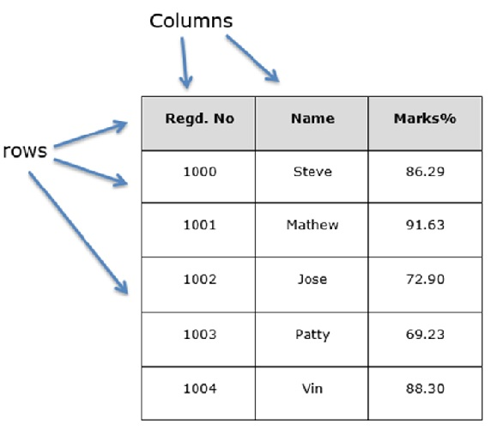
STRUCTURE
Let us assume that we are creating a data frame with student’s data

Slide 5
PANDAS.DATAFRAME
A pandas DataFrame can be created using the following constructor −
pandas.DataFrame( data, index, columns, dtype, copy)
Create an Empty DataFrame
A basic DataFrame, which can be created is an Empty Dataframe.
Example:
#import the pandas library and aliasing as pd
import pandas as pd
df = pd.DataFrame()
print df
Its output is as follows −
Empty DataFrame Columns: [] Index: []

Slide 6
EXAMPLE
import pandas as pd
data = [['Aman',10],[‘Ajay',12],[‘Abhi',13]]
df = pd.DataFrame(data,columns=['Name','Age'],dtype=float)
print df
Its Output is as follows:
Name Age
0 Aman 10.0
1 Ajay 12.0
2 Abhi 13.0

Slide 7
EXAMPLE TO CREATE CSV FILE
import pandas as pd
names = ['Bob','Jessica','Mary','John','Mel']
births = [968, 155, 77, 578, 973]
BabyDataSet = list(zip(names,births))
print(BabyDataSet)
df = pd.DataFrame(data = BabyDataSet, columns=['Names', 'Births'])
print(df)
df.to_csv('demo.csv')
Output
[('Bob', 968), ('Jessica', 155), ('Mary', 77), ('John', 578), ('Mel', 973)]
Names Births
0 Bob 968
1Jessica 155
2 Mary 77
3 John 578
4 Mel 973

Slide 8
COLUMN ADDITION
import pandas as pd
d = {'one' : pd.Series([1, 2, 3], index=['a', 'b', 'c']), 'two' : pd.Series([1, 2, 3, 4], index=['a', 'b', 'c', 'd'])}
df = pd.DataFrame(d)
# Adding a new column to an existing DataFrame object with column label by passing new series
print ("Adding a new column by passing as Series:")
df['three']=pd.Series([10,20,30],index=['a','b','c'])
print df
print ("Adding a new column using the existing columns in DataFrame:")
df['four']=df['one']+df['three']
print df
Output
Adding a new column by passing as Series:
one two three
a 1.0 1 10.0
b 2.0 2 20.0
c 3.0 3 30.0
d NaN 4 NaN
Adding a new column using the existing columns in DataFrame:
one two three four
a 1.0 1 10.0 11.0
b 2.0 2 20.0 22.0
c 3.0 3 30.0 33.0
d NaN 4 NaN

Slide 9
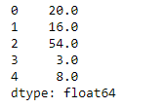
MAX
# importing pandas as pd
import pandas as pd
# Creating the dataframe
df = pd.DataFrame({"A":[12, 4, 5, None, 1],
"B":[7, 2, 54, 3, None],
"C":[20, 16, 11, 3, 8],
"D":[14, 3, None, 2, 6]})
# skip the Na values while finding the maximum
df.max(axis = 1)
Output:
Max() is used to find the maximum value .
Similarly , to find the minimum value we use min() in place of max()

Slide 10
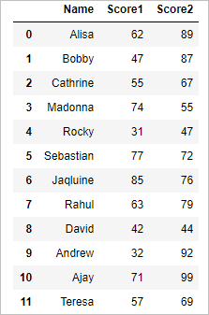
Mean Function in Python pandas
(Dataframe, Row and column wise mean)
mean() – Mean Function in python pandas is used to calculate the arithmetic mean of a given set of numbers, mean of a data frame ,mean of column and mean of rows .
import pandas as pd
import numpy as np
#Create a DataFrame
d = { 'Name':['Alisa','Bobby','Cathrine','Madonna','Rocky',
'Sebastian','Jaqluine', 'Rahul','David','Andrew','Ajay','Teresa'],
'Score1':[62,47,55,74,31,77,85,63,42,32,71,57],
'Score2':[89,87,67,55,47,72,76,79,44,92,99,69]}
df = pd.DataFrame(d)
df
# mean of the dataframe
df.mean()
Output:
Score1 58.0 Score2 73.0 dtype: float64

Slide 11
Sorting :
from pandas import DataFrame
import pandas as pd
d = {'one':[2,3,1,4,5], 'two':[5,4,3,2,1], 'letter':['a','a','b','b','c']}
df = DataFrame(d)
test = df.sort_values(['one'], ascending=[False])
the output is:
letter one two
b 1 3
0 a 2 5
a 3 4
3 b 4 2
4 c 5 1
If ascending=False , data will be sorted in descending order.
Otherwise, by default the data will be sorted in ascending order.

Slide 12
Groupby
name | age | employment_status | state
Anush | 23 | emp | pb
Ankush | 32 | unemp | pb
Alisha | 21 | emp | pb
Rohit | 34 | emp | hp
Komal | 26 | unemp | hr
Karthik | 29 | emp | hr
Output:
name age employment_status state
0 Anush 23 emp pb
1 Ankush 32 unemp pb
2 Alisha 21 emp pb
3 Rohit 34 emp hp
4 Komal 26 unemp hr
5 Karthik 29 emp hr
name
state
hp 1
hr 2
pb 3
pb 3
Hr 2
hp 1
Name: state, dtype: int64
import pandas as pd
import numpy as np
df1 = pd.read_csv('datasets/stackdatasetexample.csv')
print(df1)
#print (df1.groupby(["state"])[['name']].count())
j=df1['state'].value_counts()
print(j)

Slide 13
Drop Duplicate and missing value
Duplicate data
Missing data
A | B | C
foo | 0 | A
foo | 1 | A
foo | 1 | B
bar | 1 | A
foo | 0 | A
Aman | CSE | Python
Anu | IT
Anuradha | CSE | PHP
Nisha |  | BigData
Pankaj | CSE
Ankit |  | Java
Rohit | IT | Android
Anu | IT
import pandas as pd
df = pd.read_csv('datasets\dropduplicatesexample.csv')
print(df)
ee=df.drop_duplicates()
#print(ee) #check whole row for duplicacy
e=df.drop_duplicates(subset=['A', 'C'])
print(e) #drop rows which match on columns A and C
e.to_csv("aaa.csv")
import pandas as pd
#if we want to write 0 in those columns which have nan
#df = pd.read_csv('datasets/dropnaexample.csv')
df = pd.read_csv('datasets/dropnaexample.csv', header=None)
print(df)
df_drop_missing = df.dropna()
#print(df_drop_missing)
df_fill = df.fillna(1) #you can fill any number
print(df_fill)

Slide 14
Filters
 | name | year | salary
0 | Aman | 2017 | 40000
1 | Raman | 2017 | 24000
2 | Anita | 2017 | 31000
3 | Kajal | 2017 | 20000
4 | Arun | 2017 | 30000
5 | Aman | 2017 | 25000
Output:
Unnamed: 0 name year salary
0 0 Aman 2017 40000
1 1 Raman 2017 24000
2 2 Anita 2017 31000
3 3 Kajal 2017 20000
4 4 Arun 2017 30000
5 5 Aman 2017 25000
Unnamed: 0 name year salary
0 0 Aman 2017 40000
2 2 Anita 2017 31000
Unnamed: 0 name year salary
0 0 Aman 2017 40000
2 2 Anita 2017 31000
4 4 Arun 2017 30000
[40000 24000 31000 20000 30000 25000]
5
import pandas as pd
import numpy as np
df = pd.read_csv('datasets/filtersexample.csv')
#print(df)
filtered = df.query('salary>30000') #salary greater than 30,000
#print(filtered)
df_filtered = df[(df.salary >= 30000) & (df.year == 2017)]
#print(df_filtered)
#print(df.salary.unique()) # list of unique items
#print(df.name.nunique()) #give the count of unque values

Slide 15
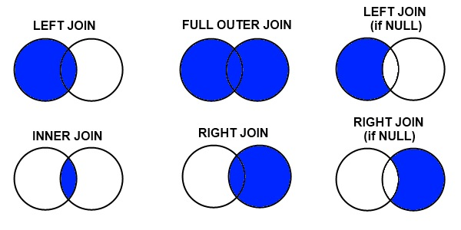
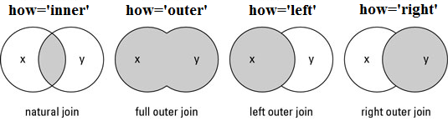
Joins

Slide 16
df_a
df_b
 | subject_id | first_name | last_name
0 | 1 | Ajay | Anderson
1 | 2 | Abhi | Ackerman
2 | 3 | Aman | Ali
3 | 4 | Avi | Aoni
4 | 5 | Aksh | Atiches
 | subject_id | first_name | last_name
0 | 4 | Billy | Bonder
1 | 5 | Navi | Black
2 | 6 | Swati | Balwner
3 | 7 | Shivali | Brice
4 | 8 | Kamal | Btisan
df_new
 | subject_id | first_name | last_name
0 | 1 | Ajay | Anderson
1 | 2 | Abhi | Ackerman
2 | 3 | Aman | Ali
3 | 4 | Avi | Aoni
4 | 5 | Aksh | Atiches
0 | 4 | Billy | Bonder
1 | 5 | Navi | Black
2 | 6 | Swati | Balwner
3 | 7 | Shivali | Brice
4 | 8 | Kamal | Btisan
df_new = pd.concat([df_a, df_b]) df_new

Slide 17
pd.concat([df_a, df_b], axis=1)
 | subject_id | first_name | last_name | subject_id | first_name | last_name
0 | 1 | Ajay | Anderson | 4 | Billy | Bonder
1 | 2 | Abhi | Ackerman | 5 | Navi | Black
2 | 3 | Aman | Ali | 6 | Swati | Balwner
3 | 4 | Avi | Aoni | 7 | Shivali | Brice
4 | 5 | Aksh | Atiches | 8 | Kamal | Btisan

Slide 18
Merge with right join
pd.merge(df_a, df_b, on='subject_id', how='right')
 | subject_id | first_name_x | last_name_x | first_name_y | last_name_y
0 | 4 | Avi | Aoni | Billy | Bonder
1 | 5 | Aksh | Atiches | Navi | Black
2 | 6 | NaN | NaN | Swati | Balwner
3 | 7 | NaN | NaN | Shivali | Brice
4 | 8 | NaN | NaN | Kamal | Btisan

Slide 19
Merge with left join
“Left outer join produces a complete set of records from Table A, with the matching records (where available) in Table B. If there is no match, the right side will contain null.”
pd.merge(df_a, df_b, on='subject_id', how='left')
 | subject_id | first_name_x | last_name_x | first_name_y | last_name_y
0 | 1 | Ajay | Anderson | NaN | NaN
1 | 2 | Abhi | Ackerman | NaN | NaN
2 | 3 | Aman | Ali | NaN | NaN
3 | 4 | Avi | Aoni | Billy | Bonder
4 | 5 | Aksh | Atiches | Navi | Black

Slide 20
Merge with inner join
“Inner join produces only the set of records that match in both Table A and Table B.”
pd.merge(df_a, df_b, on='subject_id', how='inner')
 | subject_id | first_name_x | last_name_x | first_name_y | last_name_y
0 | 4 | Avi | Aoni | Billy | Bonder
1 | 5 | Aksh | Atiches | Navi | Black

Slide 21
Merge with outer join
“Full outer join produces the set of all records in Table A and Table B, with matching records from both sides where available. If there is no match, the missing side will contain null.”
pd.merge(df_a, df_b, on='subject_id', how='outer')
 | subject_id | first_name_x | last_name_x | first_name_y | last_name_y
0 | 1 | Ajay | Anderson | NaN | NaN
1 | 2 | Abhi | Ackerman | NaN | NaN
2 | 3 | Aman | Ali | NaN | NaN
3 | 4 | Avi | Aoni | Billy | Bonder
4 | 5 | Aksh | Atiches | Navi | Black
5 | 6 | NaN | NaN | Swati | Balwner
6 | 7 | NaN | NaN | Shivali | Brice
7 | 8 | NaN | NaN | Kamal | Btisan

